Slide 1
Psychoanalytical Readings
Secret River
Mrs Ryan 2023

Slide 2
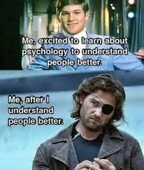
What is a psychoanalytical reading?
A psychoanalytical reading is one which explores the ways that psychological issues are played out in the characters.
Everyone has psychological ‘issues’ to some degree, because everyone experiences conflict in their life. Psychological problems are a natural and unavoidable part of being human.
Knowledge is power; by identifying and discussing these issues we can better understand ourselves and ‘heal’.
Analyzing characters psychoanalytically helps us understand the effects of family and society on the individual and their behaviour.

Slide 3

Main Psychological Factors influencing behaviour…
Family: childhood and relationships with parents.
Repression:
“Emotion denied, is emotion deferred”.
We tend to deny, repress, and push out of sight those experiences that are most distressing to us.
This can lead to unconscious patterns in self-destructive behaviour.
We enact, or play out, our problems in our relationships with other people.

Slide 4
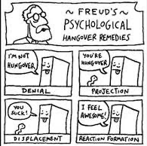
3. Defenses:
Strategies we have for protecting ourselves emotionally.
The means by which we keep ourselves from becoming conscious of the experiences we’ve repressed.
These can be destructive as they stop us from dealing with our issues and therefore healing.
Common defenses include:
Denial – refusing to admit there is a problem
Avoidance – staying away from the people, places or situations that may ‘trigger’ us.
Displacement – Taking our negative feelings out on others.
Projection – When we see our own issues in other people and attack them for it to prove to ourselves that we don’t have that issue. E.g., attacking someone for ‘being gay’, to prove to ourselves and others that we are not gay (when we are).

Slide 5

Core conflicts/issues
At the basis of self-destructive behaviour, there is a core issue or conflict.
Common core issues include:
Low self-esteem and a sense of not being worthy
Insecure or unstable sense of self and identity
Oedipal fixation – a dysfunctional fixation or emotional bond with the parent of the opposite sex
Fear of intimacy and emotional closeness
Fear of abandonment, emotional or physical

Slide 6

To recap…
A distressing event or situation that occurs in our youth is repressed into our unconscious because we don’t feel we can face it consciously.
We keep our repressed experiences buried in our unconscious through the use of our defenses.
If the experience buried in our unconscious affects us powerfully enough it will become a core issue – a fundamental part of our personality.
Core issues result in the repetition of certain self-destructive behaviors.

Slide 7

Time to put your psych hat on…
Pretend you have a character laying on your psychologist’s couch, and you want to get to the bottom of the psychological drives of their behaviour. You could ask:
1. Is there any traumatic experiences in their childhood?
2. Are they exhibiting any defensive behaviour that would indicate repression (denial, avoidance, displacement, projection)?
3. What is their core issue (low self-esteem, unstable identity, oedipal complex, fear of abandonment and intimacy)?
4. What destructive behaviours may be caused by this core issue?

Slide 8




1. Is there any traumatic experience in their childhood?
2. Are they exhibiting any defensive behaviour that would indicate repression (denial, avoidance, displacement, projection)?
3. What is their core issue (low self-esteem, unstable identity, oedipal complex, fear of abandonment and intimacy)?
4. What destructive behaviors may be caused by this core issue?
Yes, poverty and deprivation. His mother was distant and he grew up amongst crime and immorality. He was sentenced to death but then exiled instead.
Avoidance: Doesn’t want to return to London or see Smasher after he discovers the sex slave.
Displacement: Enjoys the power of owning convicts and making them work in the sun.
Projection: doesn’t want to believe that what he is doing is wrong so tries to believe that he is the victim and the Indigenous people are the aggressors, justifying their massacre.
Low self-esteem: Tries to make himself look big by spending money, getting portraits painted of himself etc.
Not acting on his knowledge of the sex slave.
Taking part in the massacre at Blackwood’s
Lying to and distancing from his wife.
Guilt towards the Indigenous man ‘Jack’
Beats son.
Thornhill

Slide 9

So what if a made-up character needs therapy?
Literature is a reflection of ourselves.
Like reading about other aspects of the human condition such as ethics, love and aging, psychoanalytical readings help us to understand ourselves better.
They also help us to understand society influences our psychology as individuals.
For instance, by combining a class and analytical reading you could seek to explain how in many ways the inequality and poverty of the lower classes in Victorian society produced dysfunctional and immoral adults.
A post-colonial lens with psychoanalytical insights could seek to understand how human beings could justify treating each other so horrifically, and the ramifications of that.

Slide 10

What have you learnt?
What are some lessons you have learnt from psychoanalyzing Thornhill?
Consider…
Class
Colonialism
Power
Guilt
Poverty
Violence

Slide 11

Other psychoanalytical approaches to consider…
Thanatos – the death drive
Libido/eros – the sex drive
Superego, id and ego
Dreams
Jungian Archetypes

Slide 12

Thanatos – the death drive (dun dun dun!)
The idea that humans have an inborn compulsion to seek oblivion, otherwise why would we exhibit self-destructive behaviors?
Paradoxically, this is linked to the fear of death, and therefore the fear of abandonment After all, death is the ultimate abandonment.
No matter how important, popular and loved we are, we die alone. Even if we die physically next to someone.
One of the greatest comforts of religion is that we will NOT die alone, that god will not abandon us.
This fear can lead to defensive behaviours: If I don’t get too close to people it won’t hurt as much when they die. In this way fear of death can lead to fear of intimacy, emotions and life itself.
How to deal with death is a psychological challenge at the heart of the human condition.

Slide 13

“Let’s talk about sex baby, let’s talk about you and me..”
Eros or libido is not just about sex, it is about the affirmation of life, opposing the death drive.
Psychoanalysts do not approach sex as merely physical desire; it is primarily psychological and therefore a good indicator of the psychological state in general.
Sexuality is a cultural construct, and what is deemed ‘normal’, and ‘deviant’ is dependent on society’s views. Individuals who do not conform to society’s expectations are conditioned to feel guilt and shame.
Questions to consider:
Does the character use sex to ‘purchase’ something from their partner?
Does the character withhold sex to ‘punish’ their partner?
Is the character promiscuous?
Does the character avoid sexual encounters entirely?
What is the emotional response of the character after sex?

Slide 14
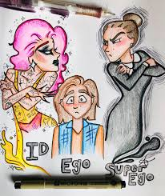

Freud and the superego, ego and id.
Superego: the repository of society’s values and taboos by which we feel guilty. Our conscious and moral compass.
Id: The psychological reservoir of forbidden desires and appetites for sex, power, food and amusement.
Ego: The conscious decision-making self that experiences the world through the senses and is the source of our self-image. It referees the conflict between the superego and id.

Slide 15
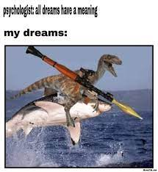
Dreams
Psychologist: All dreams have a meaning.
We can interpret literary texts as dreams, as they have ‘dreamed up’ the story.
Common dream symbols include:
Water = emotions/sexuality and unpredictability.
Buildings = Self, body
Basements = The unconscious, repressed unpleasant memories.
Attics = Intellect, conscious mind. Can also be the opposite: the storage place for unwanted repressed memories.
Phallic symbols = penis-shaped things, e.g., towers, guns, serpents, swords etc. associated with masculinity.
Womb imagery = enclosed spaces that are a sanctuary e.g., walled gardens, caves, hearth/home, cocoons etc.

Slide 16
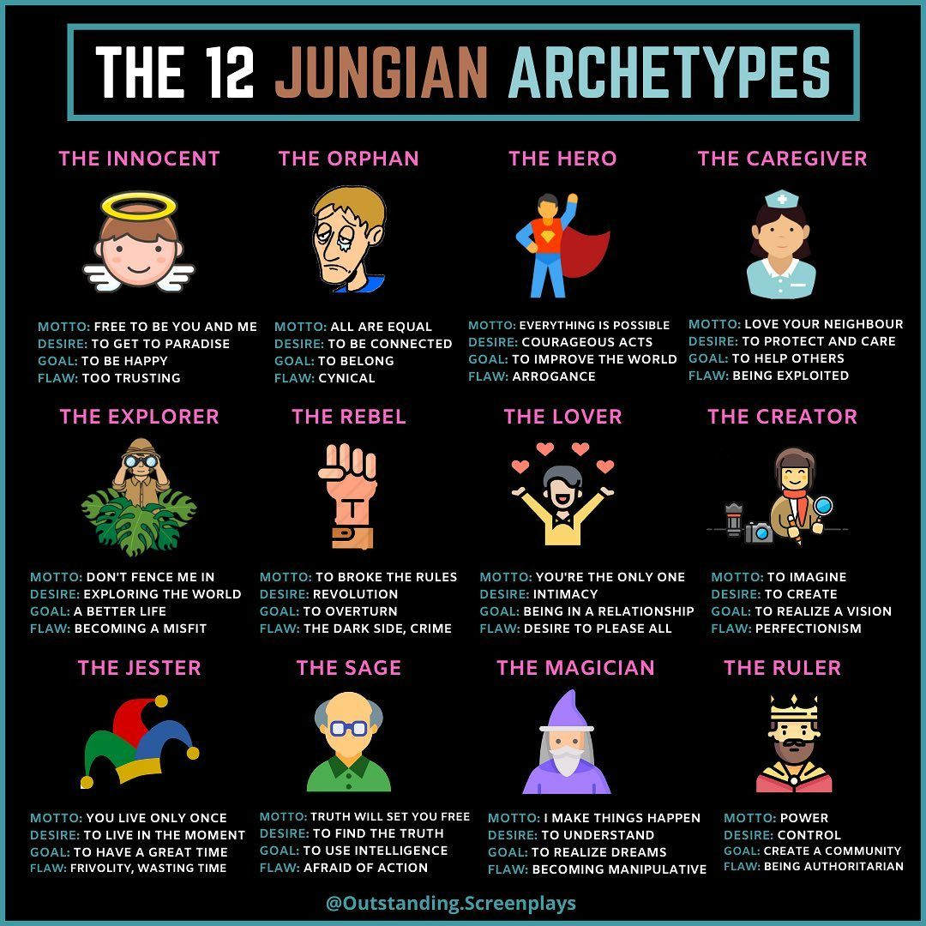
The psychiatrist Carl Jung turned away from Freudian ideas and explored ancestral roots and the collective unconscious.
To define his 12 archetypes of personality, Jung studied the symbols and myths of many different cultures.
These archetypes represent behaviour patterns that make up different ways of being.
They’re cultural symbols and images that exist in our collective unconscious.
Literary characters often fall into these archetypes: women in literature most commonly fall into the mother, maiden and seductress archetypes.

Slide 17
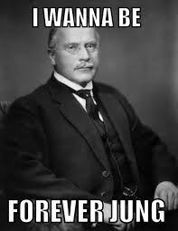
Thornhill – final reflection
Does Thornhill have a death drive/fear of death? How does this affect his behavior?
What is Thornhill’s sexual relationship like? Does it change over the course of the novel?
How does his ego, id and superego interact? Which tends to win?
Are there any dream symbols in the novel? What could they symbolize?
What archetype do you think he fits into?

